Slide 1

Presence of women in sports
A step towards EQUITY
Presented by
Sahithi Kodali
Sanskriti Motwani
Tejaswini Satish Kumar

Slide 2
Agenda
Problem Statement
Importance and Motivation
Insights and Observations
Implementations
Results
Future Work

Slide 3
Problem Statement
Understand female athletes' performance in the past to interpret their performance in the future.
Understand the factors affecting their performance and how these factors differ from those of male athletes.
Interpret the female player performance based on the given factors/features and focus on game-based improvement.

Slide 4
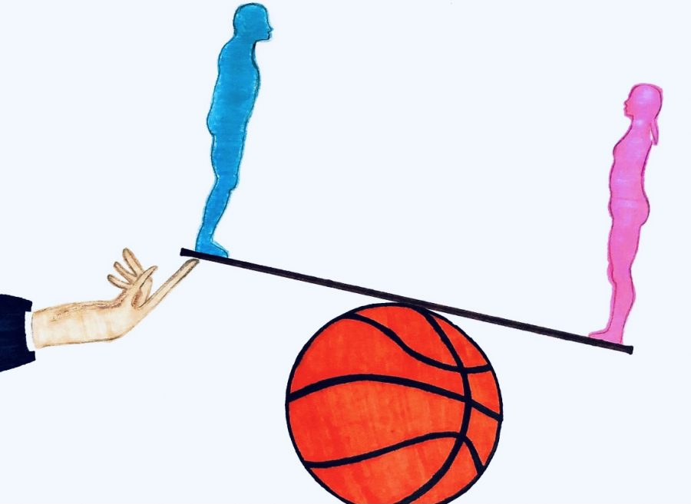
Importance and Motivation
Female empowerment is a crucial aspect that needs to be addressed in various walks of life.
Literature reviews, research and clinical studies show underrepresentation of women.
Significant difference in women participation in sports.
Gain insight into participation and performance of women in sports.
Assist women and coaches dreaming of careers in sports by efficient interpretations.
https://marquettemessenger.com/opinion/2021/04/21/womens-basketball-team-faces-gender-inequality-at-ncaa-march-madness/

Slide 5
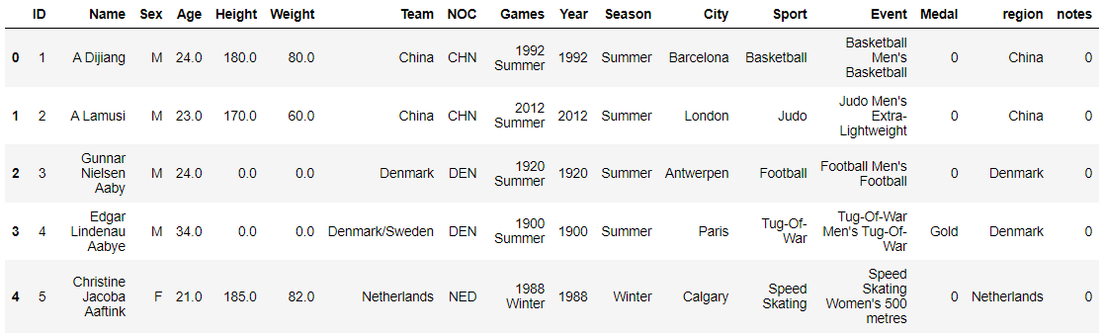
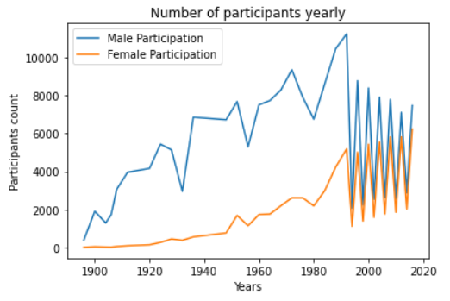
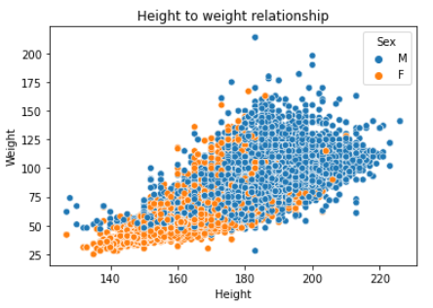
Insights and Observations
Analyzing 120 years of Olympic Games Athletes dataset

Slide 6
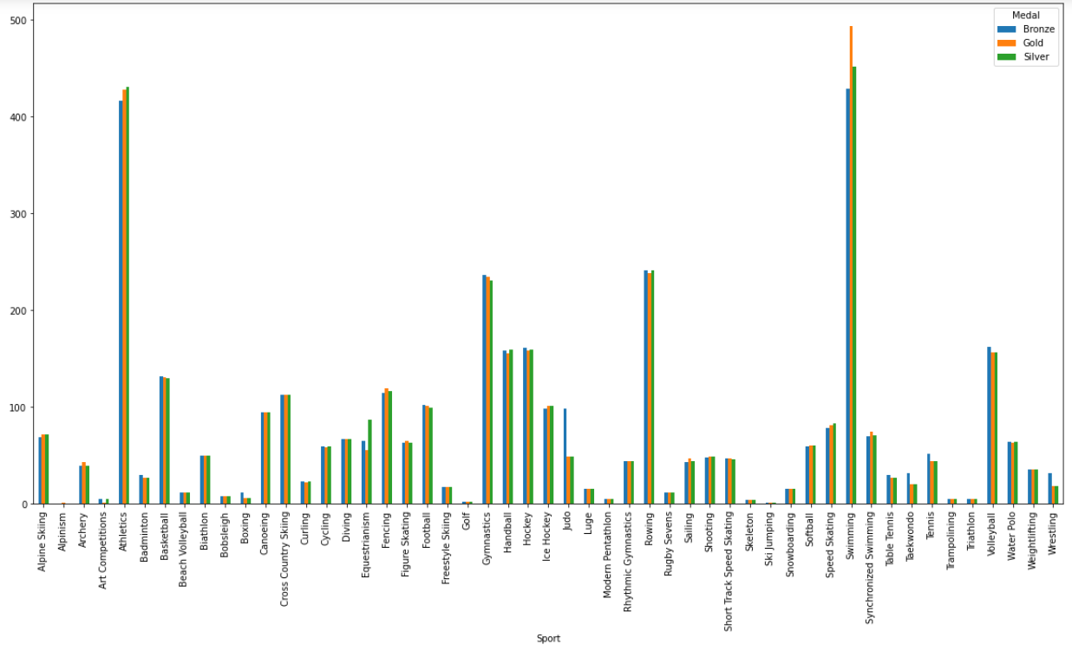
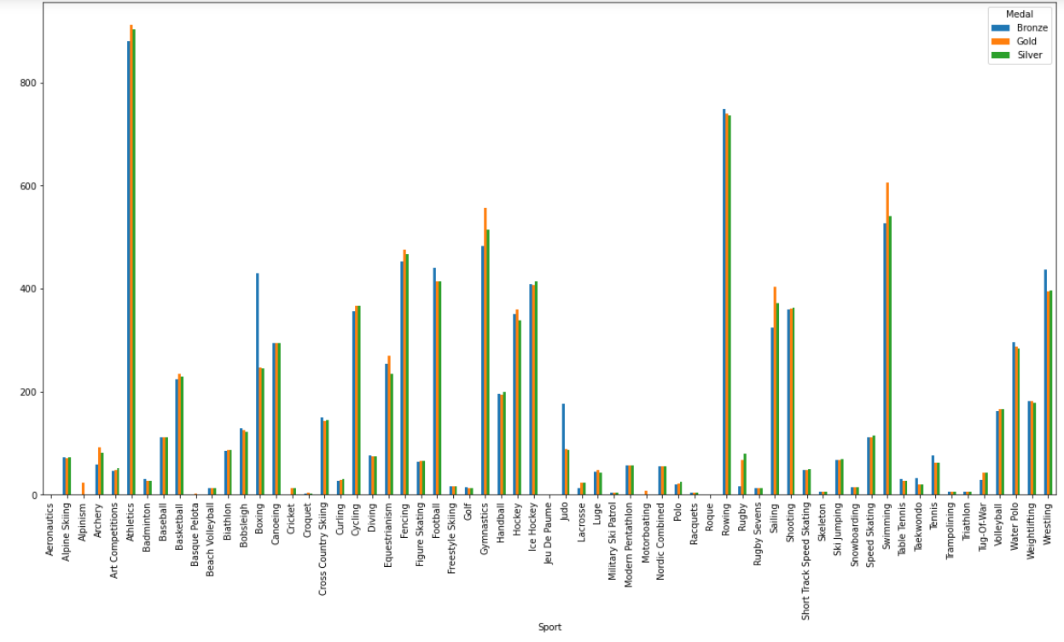
Medals secured by Female in each sport
Medals secured by Male in each sport

Slide 7
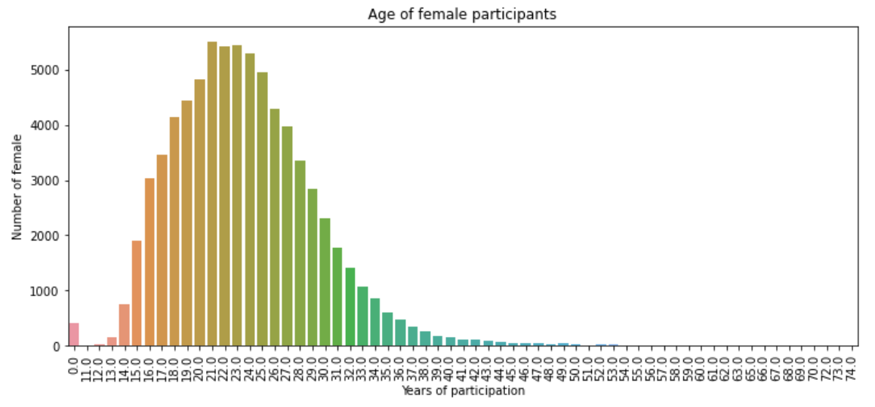
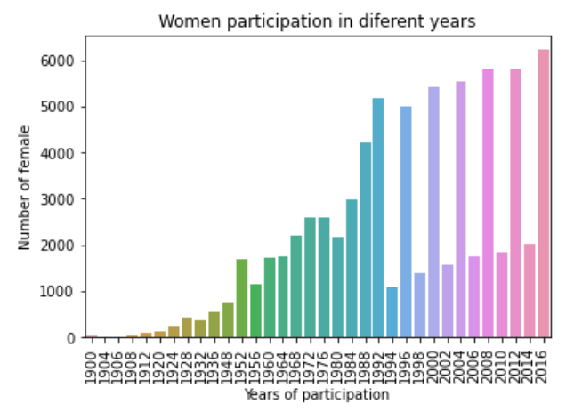
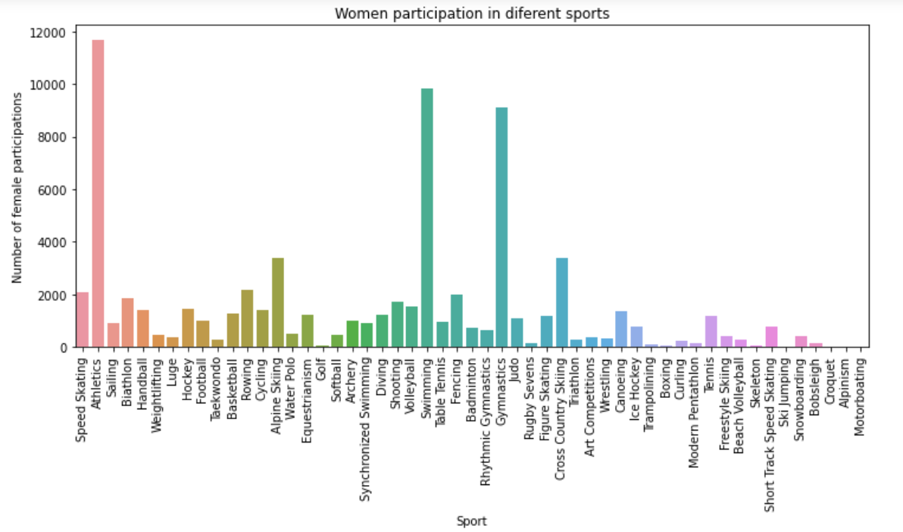
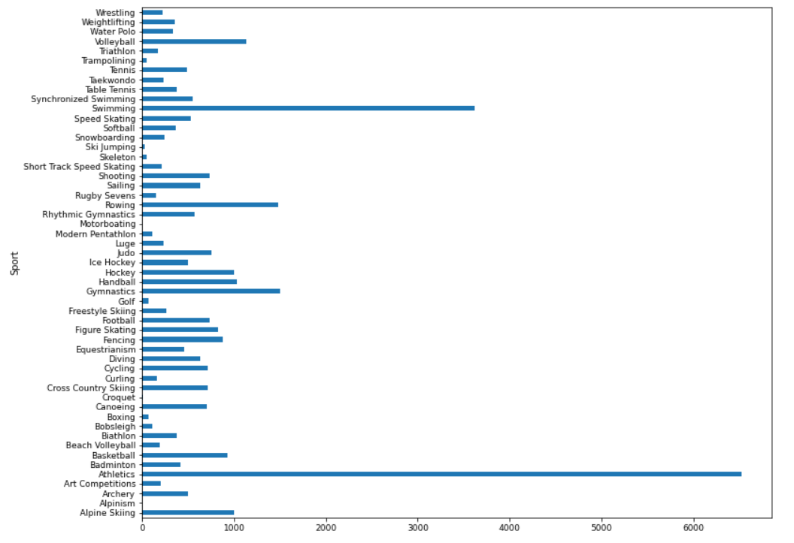
Unique women players in each sport

Slide 8
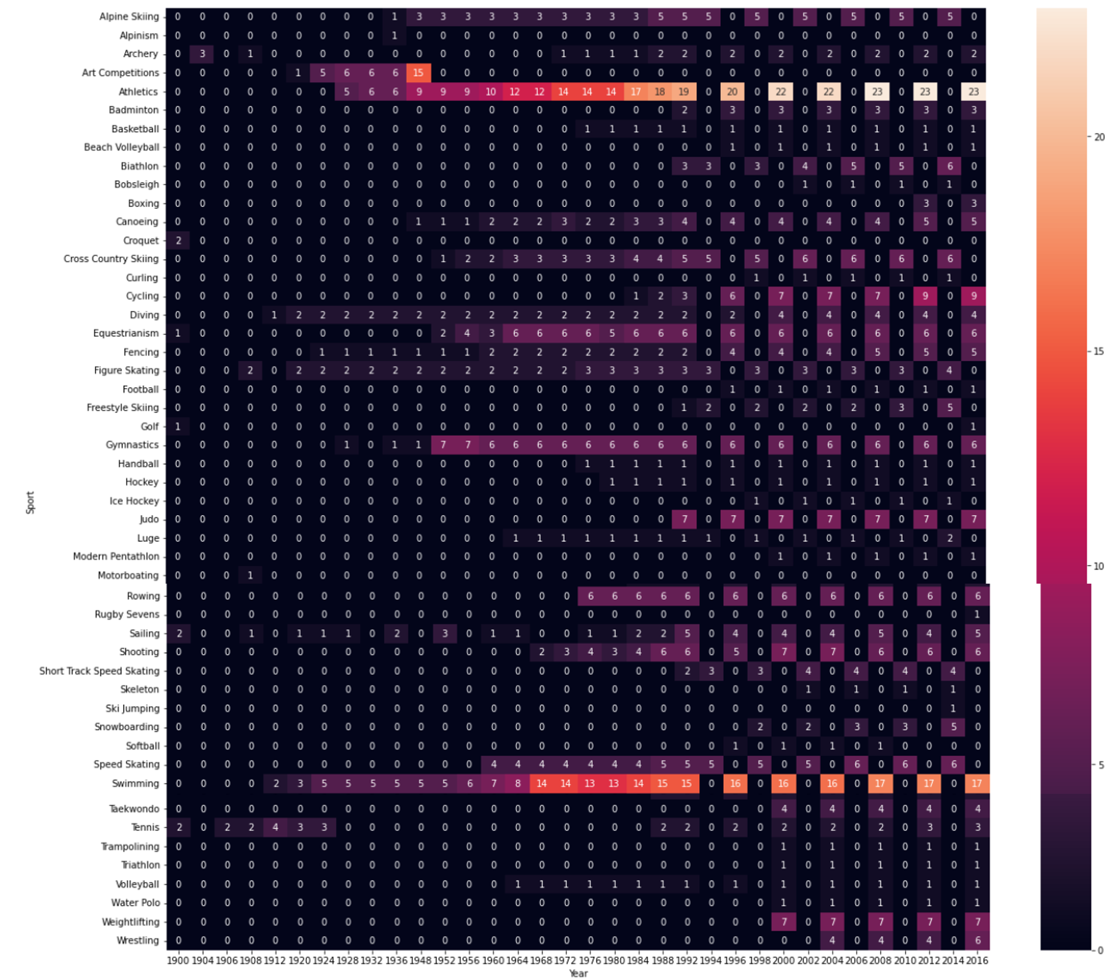
Showcasing the number of events women
participated based on year and sport

Slide 9
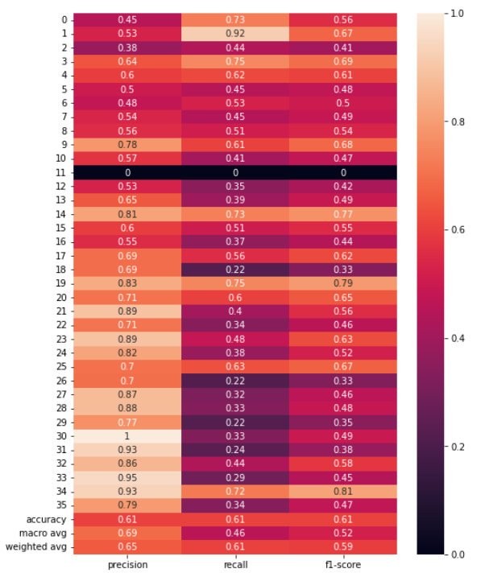
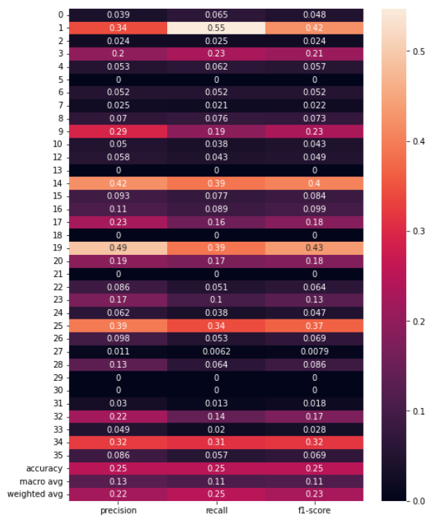
Implementation
Predict top 5 sports based on physical factors
Using Decision Tree
Training results
Testing results

Slide 10
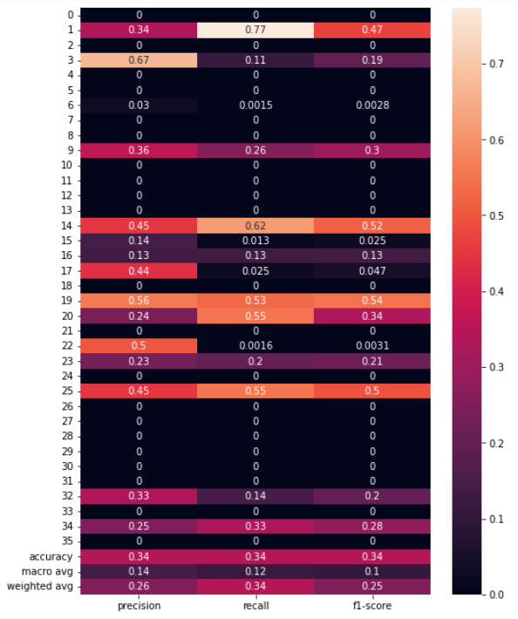
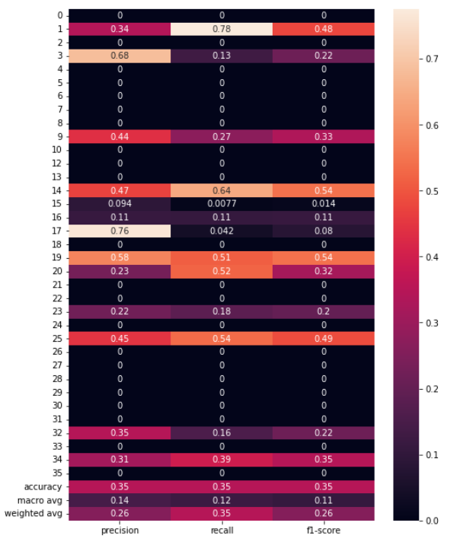
Predict top 5 sports based on physical factors
Using Neural Networks
Training results
Testing results
Training results

Slide 11
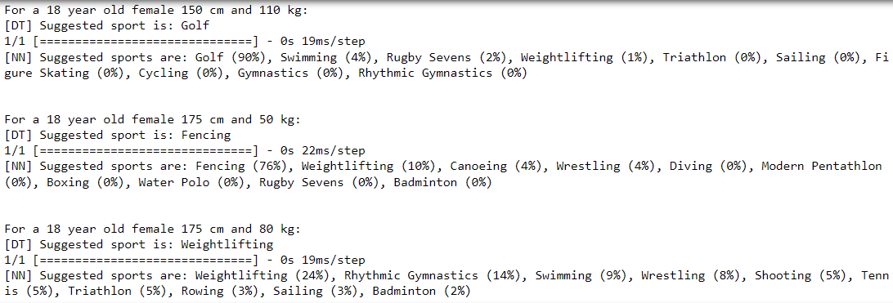
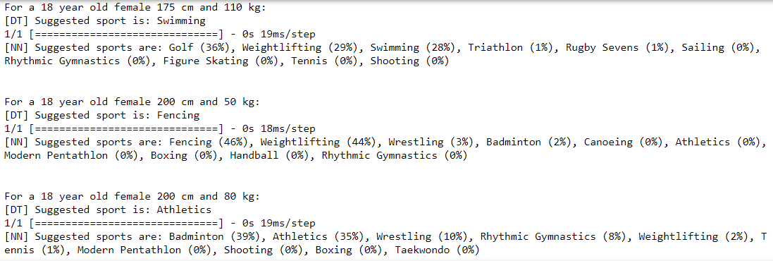
Predict top 5 sports based on physical factors
Comparing results of Decision Tree and Neural Network

Slide 12
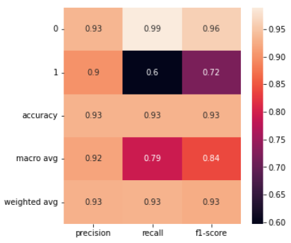
Predict if a female player can achieve a medal based on sport, physical and regional factors
Using Random Forest
11/21/2022
12

Slide 13
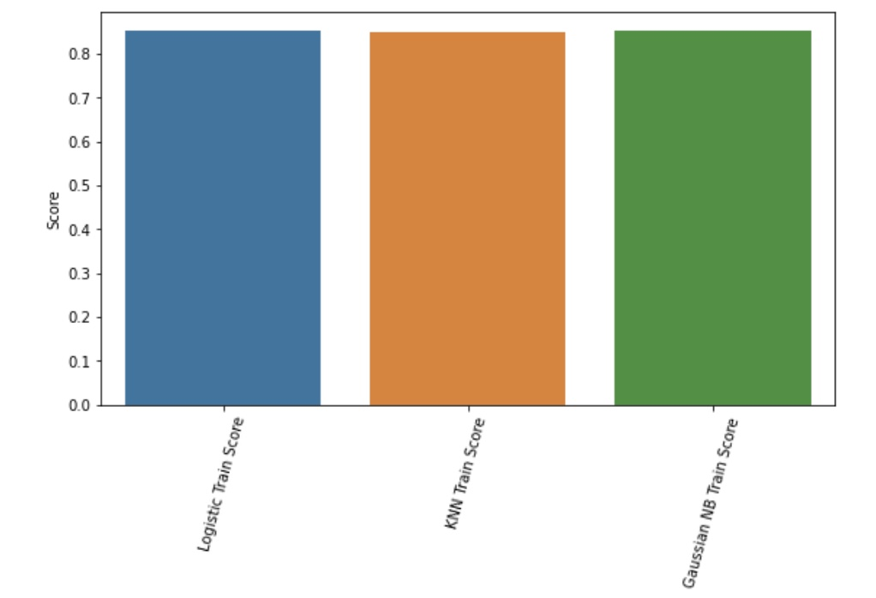
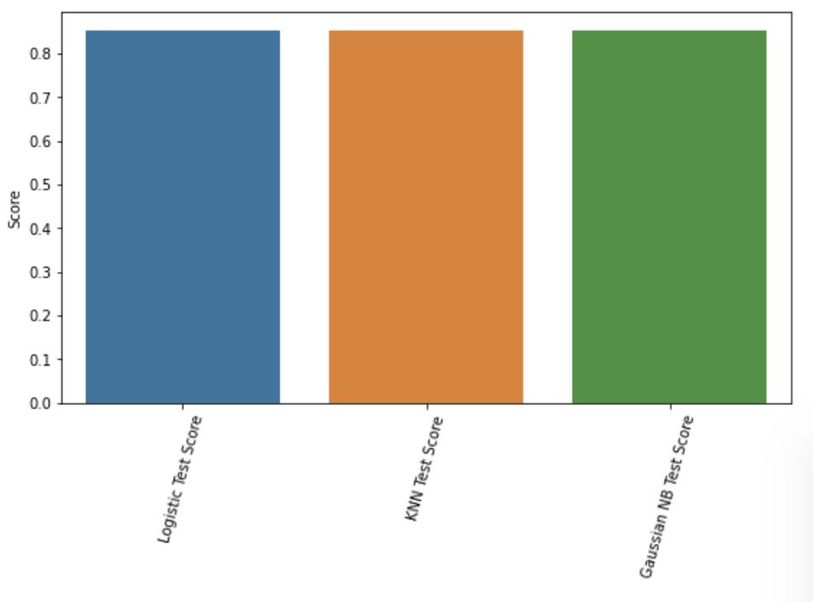
Predict if a player can achieve a medal based on sport, physical and regional factors using a few other classifiers
Using KNN, Logistic and Naïve Bayes
Understanding importance of feature vectors in predicting female athletes' performance in Olympics
There are multiple factors that affect participation and performance.
In the dataset, the feature vector “country” has the highest coefficiency.

Slide 14
Improve your Tennis Game !!!
What statistics lead to the most wins?
tourney_id | tourney_name | surface | draw_size | tourney_level | tourney_date | match_num
winner_id | winner_seed | winner_entry | winner_name | winner_hand | winner_ht | winner_ioc
winner_age | loser_id | loser_seed | loser_entry | loser_name | loser_hand | loser_ht
loser_ioc | loser_age | score | best_of | round | minutes | w_ace
w_df | w_svpt | w_1stIn | w_1stWon | w_2ndWon | w_SvGms | w_bpSaved
w_bpFaced | l_ace | l_df | l_svpt | l_1stIn | l_1stWon | l_2ndWon
l_SvGms | l_bpSaved | l_bpFaced | winner_rank | winner_rank_points | loser_rank | loser_rank_points
Dataset sample

Slide 15
Improve your Tennis Game !!!
Using Decision Tree Classifier
Accuracy - 0.8418756815703381 (Without specifying max depth)

Slide 16
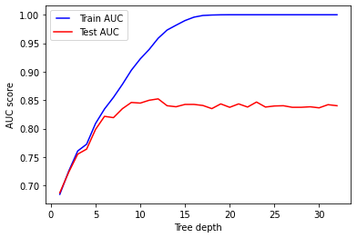

Improve your Tennis Game !!!
Using Decision Tree Classifier
What’s the right tree depth?
Accuracy - 0.8478735005452562 (with max depth = 12)
Remove some non-statistical features
Accuracy - 0.8527808069792803 (with max depth = 13)

Slide 17
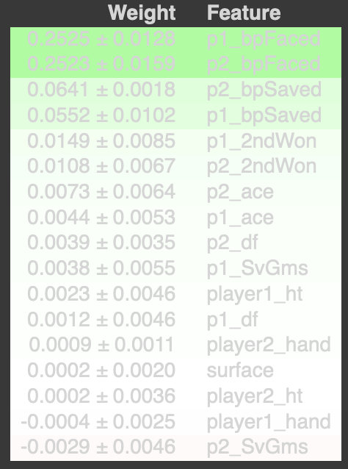
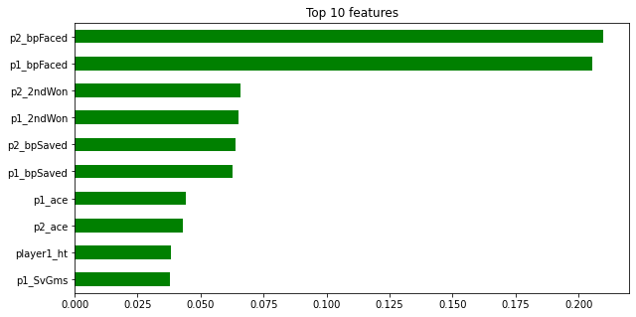
Improve your Tennis Game !!!
Using Random Forest Classifier
Accuracy - 0.8800436205016358
Number of estimators - 100
Accuracy using 0.01 minimum importance - 0.9122137404580153
Permutation importance's

Slide 18
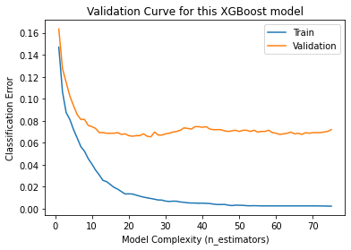
Improve your Tennis Game !!!
Using XGBoost Classifier
Accuracy - 0.9603426701318702 (best accuracy so far!)

Slide 19
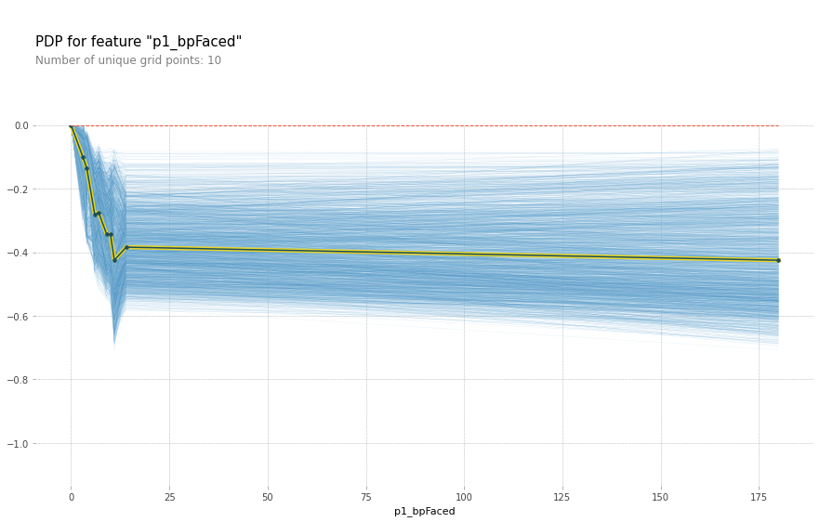
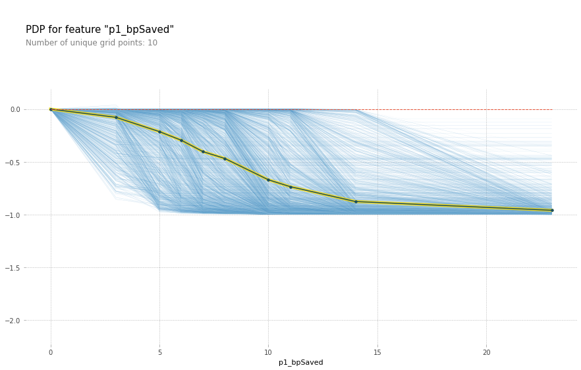
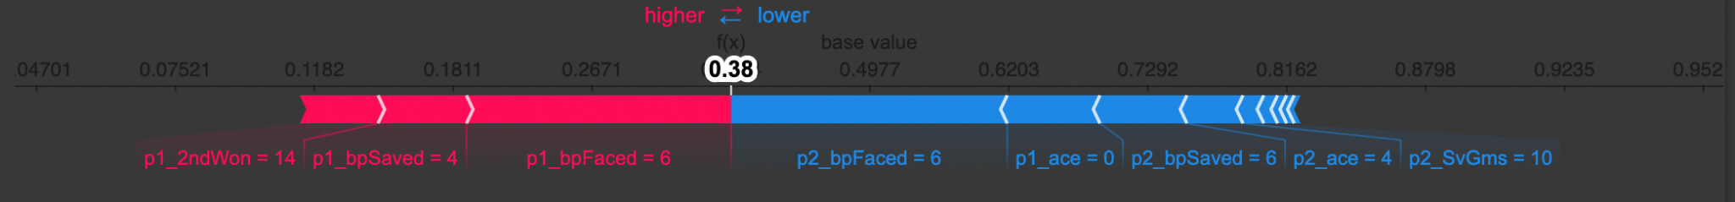
Improve your Tennis Game !!!
What can a player Improve?

Slide 20
Results
Visualized data to compare gender-based participation and performance.
Determined the importance of features that contribute to predicting player performance.
Used classifiers to predict the probability of winning a medal (working on predicting the type of the medal).
Predicted the top 5 sports a female player can thrive in based on physical factors.
Utilized Tennis statistics to improve the performance of a player efficiently.

Slide 21
Future work
Determine attributes that can improve player performance in other sports (similar to the Tennis based prediction).
Include skills measurement for each sport based on physical attributes of a player and compare to the best skill set measurements and suggest nutritional information/diet to attain such skills.
Perform similar evaluation and prediction for other genders to promote gender inclusivity in sports.

Slide 22
Thank You

